Slide 1
LOAN DEFAULT PREDICTION
RAHUL THAPA MAGAR
ADVISOR: DR. KHALID ABOALAYON
COURSE: MSDA3999 Summer 2023

Slide 2
Table of Contents
Introduction
Methods and Outputs
Recommendations/Conclusion
Professional Development
References & Acknowledgements
Discussion

Slide 3
Introduction
Loan defaulters pose a financial risk to banking institutions.
Technology offers predictive tools to mitigate the risk.
Build a predictive model that classifies borrowers as potential defaulters or non-defaulters.
Stakeholders
Banks: Minimize revenue loss, streamline loan approval processes, and maintain a healthy balance sheet.
Borrowers: Receive fair loan assessments based on data-driven evaluations.
Economy: Stable banking sector leading to economic resilience.

Slide 4
About the Datasets
The provided datasets corresponds to all loans issued individual from 2007-2015
The datasets has 252000 rows and 13 columns
Variables includes income, age, experience, marital_status, house_ownership etc and the target variable is risk_flag (0/1)

Slide 5
Research Questions
How to predict the loan default?
Which is the best prediction model?
What variable influences the outcome?

Slide 6
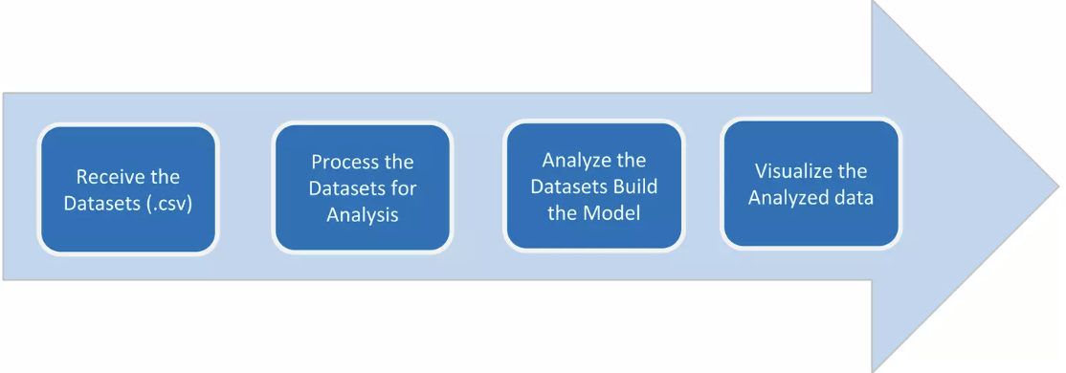
Data Analysis Process
Before applying machine learning model, its imperative to understand the nature of data.

Slide 7
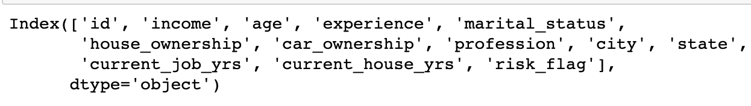

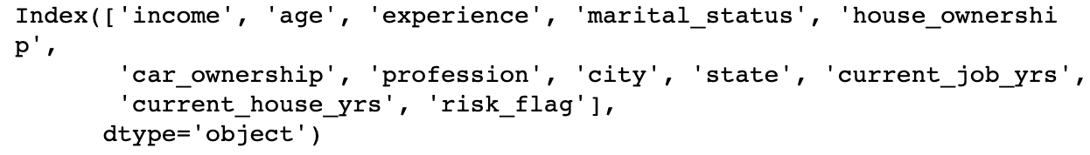
Data Preprocessing
Irrelevant Data:

Slide 8
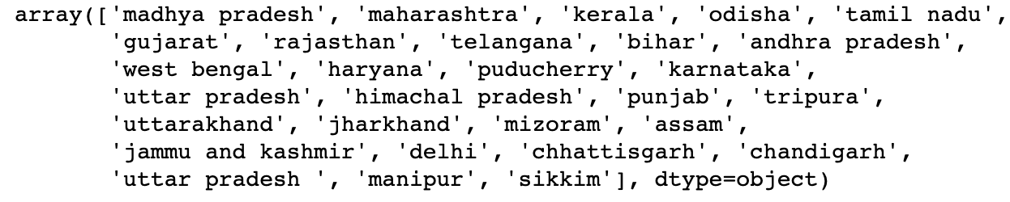
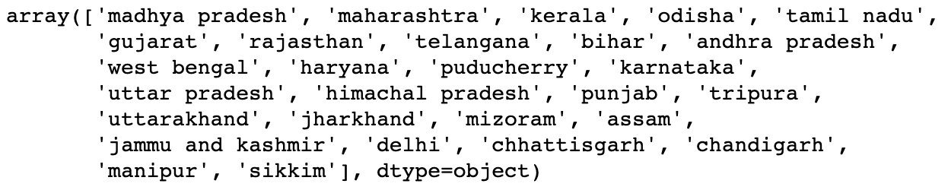
Data Preprocessing
Duplicate Fields:

Slide 9
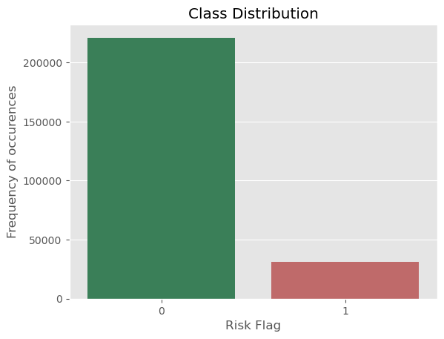
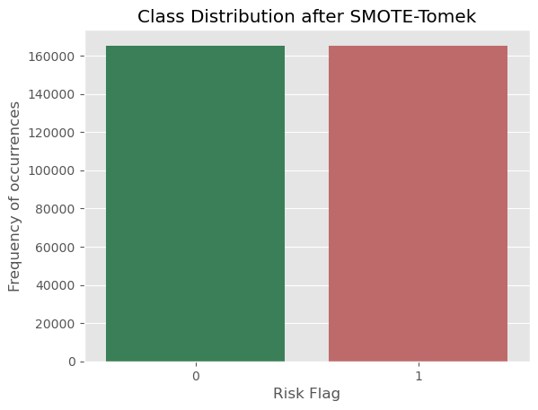
Data Preprocessing
Imbalance Datasets:

Slide 10
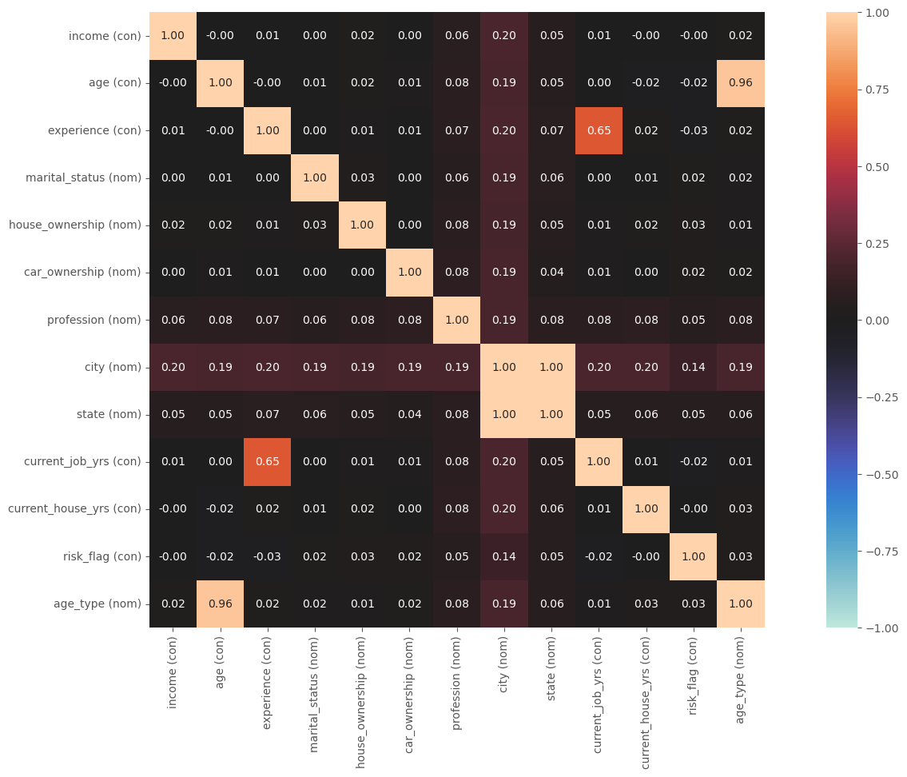
Exploratory Data Analysis(EDA)
Correlation Plot:
"Experience and Current_job_years are strongly positively correlated because as one increases, the other does as well."

Slide 11
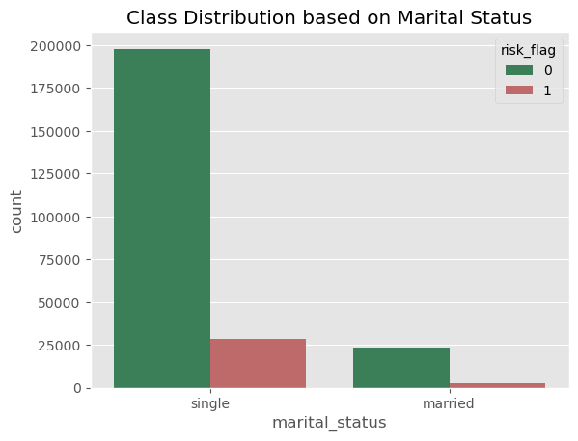
Exploratory Data Analysis(EDA)
Class Distribution - Marital Status:
"Despite 90% of customers being single, they only have a 2% higher loan default rate (12%) compared to the married group (10%)."

Slide 12
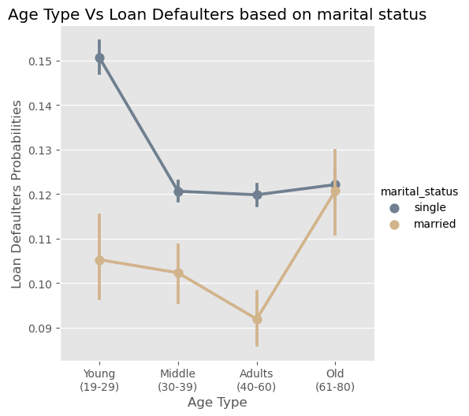
Exploratory Data Analysis(EDA)
Age-Grouped Analysis of Loan Default Trends by Marital Status:
"Married customers have a lower default rate compared to those who are Single in every age group."

Slide 13
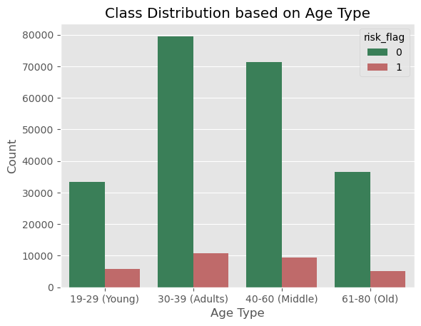
Exploratory Data Analysis(EDA)
Class Distribution – Age Type:
"Young customers, making up 39K of our dataset, have the highest default rate at 14.6%, while our 80K Middle customers exhibit the lowest at 11.6%."

Slide 14
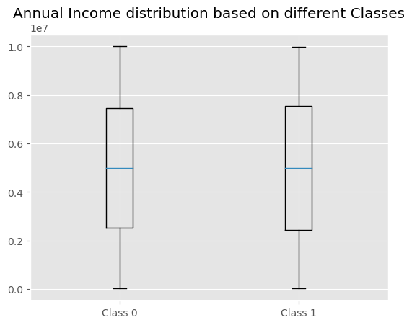
Exploratory Data Analysis(EDA)
Class Distribution – Annual Income:
"The box plot for both classes is nearly identical, with no outliers detected."

Slide 15
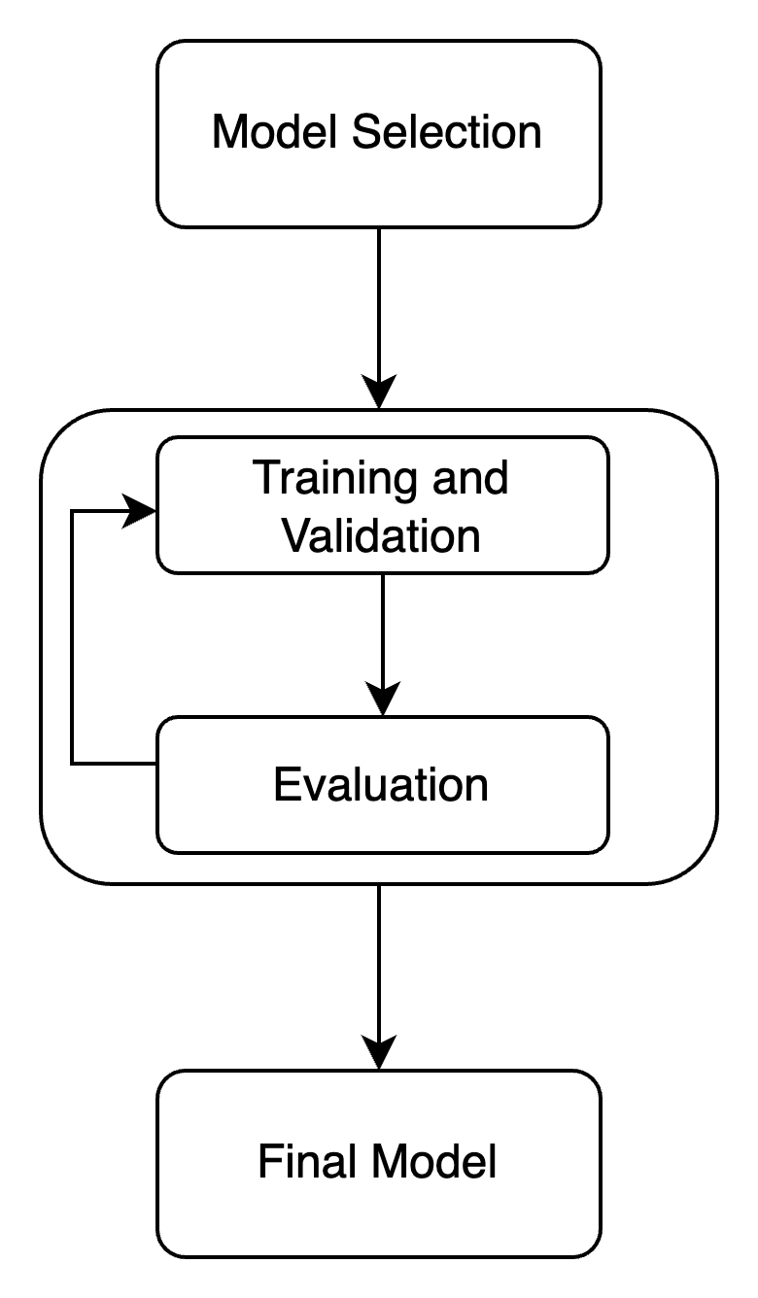
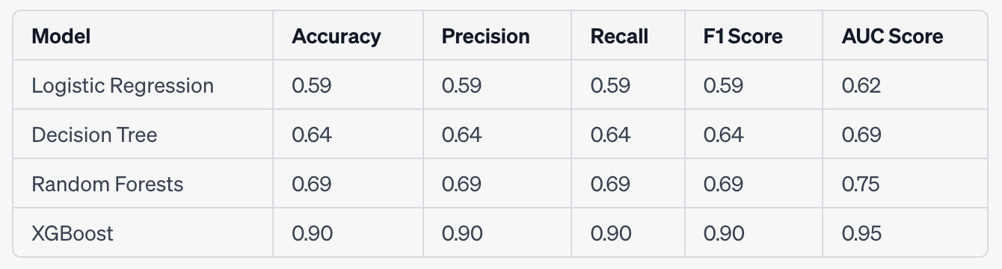
Model Selection & Comparison
The XGBoost model surpassed other models like Logistic Regression, Decision Trees, and Random Forest, achieving a notable AUC score of 0.95 in predicting loan defaults.

Slide 16
Recommendations/Conclusion
Focus on middle-aged customers, as they exhibit the lowest default rate of 11.6%.
Prioritize marital status, as married individuals show lower default rates, indicating higher creditworthiness.
Launch campaigns for younger customers, highlighting financial responsibility, given their 14.6% default rate.
Adopt the XGB model for credit scoring due to its superior ROC, AUC, and performance metrics.
The project may not encompass the full scope of loan default risk; future approaches should focus on updated data, broader factors, and improved prediction techniques.

Slide 17
Professional Development
Managed large datasets, ensuring accuracy and addressing duplicates.
Gained expertise in EDA, uncovering insights and patterns from raw data using various statistical techniques.
Enhanced proficiency in selecting and evaluating machine learning models, understanding their behaviors and outcomes.
Formulated research questions and honed an analytical approach to comprehend the underlying reasons in data.

Slide 18
Acknowledgements
I would like to extend my heartfelt gratitude to my advisor, Dr. Khalid Aboalayon, whose guidance, expertise, and unwavering support have been instrumental in the success of this project. His insights and feedback were invaluable in shaping this work. I am also deeply appreciative of all the individuals and organizations that contributed to various capacities, providing resources, data, and expertise. Your collective contributions have been paramount, and I am eternally grateful.

Slide 19
References
Bellotti, T., & Crook, J. (2009). Support vector machines for credit scoring and discovery of significant features. Expert Systems with Applications, 36(2), 3302-3308.
Huang, J., Chen, Y., & Wang, S. (2007). Credit scoring with a data mining approach based on support vector machines. Expert Systems with Applications, 33(4), 847-856.
Lessmann, S., Baesens, B., Seow, H.V., & Thomas, L.C. (2015). Benchmarking state-of-the-art classification algorithms for credit scoring: An update of research. European Journal of Operational Research, 247(1), 124-136.
Louzis, D.P., Vouldis, A.T., & Metaxas, V.L. (2012). Macroeconomic and bank-specific determinants of non-performing loans in Greece: A comparative study of mortgage, business and consumer loan portfolios. Journal of Banking & Finance, 36(4), 1012-1027.
Thomas, L.C., Edelman, D.B., & Crook, J.N. (2002). Credit scoring and its applications. SIAM.

Slide 20

Discussion

Slide 21
Thank you

